Slide 1
CSE1142 – C Data Types
Sanem Arslan Yılmaz
Some of the slides are from:
CMPE150 – Boğaziçi University
Deitel & Associates

Slide 2
Agenda
Variables
    What are they used for?
    Rules for identifier names
Standart Data Types
  Integer
  Floating-point numbers
  Characters
Constants
Enumerated type
Operators
Type casting

Slide 3
Variables
Operations (such as addition, subtraction, etc.) operate on operands.
You need some space to store the value of each operand.
A variable provides storage space for a value.

Slide 4
Variables
IMPORTANT: The value of a variable can never be empty. The value is represented via multiple bits, each of which is either 0 or 1. So, the variable always has a value.
When a local variable is defined, its initial value is undefined. In other words, it has an arbitrary value.
So, make sure that the variable has a valid value before you perform any operation based on that value.

Slide 5
Variables
Each variable consists of multiple bits. E.g.:
Thus, every value is actually stored as a sequence of bits (1s and 0s) in the computer.
The number of bits is called the size of the variable.
The size of a variable depends on the type of the variable, the hardware, the operating system, and the compiler used.
  So, in your programs NEVER make assumptions about the size of a variable.
  The size may change due to the factors listed above, and your program will not work.
15
14
13
12
11
10
9
8
7
6
5
4
3
2
1
0
0
0
1
0
0
1
1
0
1
0
1
1
0
1
1
1
➔ 2¹³+2¹⁰+2⁹+2⁷+2⁵+2⁴+2²+2¹+2⁰=9911

Slide 6
Variables
#include <stdio.h>
int main
{
int a, b, c;
a=10;
b=3;
c=a-b;
a=b+2;
}
Program
a
...
5
10
b
...
3
c
...
7

Slide 7
Rules for identifier names
While defining names for variables (and also functions, user-defined types, and constants in the future) you should obey the following rules:
  The first character of a name must be a letter or underscore (‘_’).
  The remaining characters must be letters, digits, or underscore.
  Only the first 31 characters are significant.
  Avoid reserved words such as int, float, char, etc. as identifier names.
However, it is better to avoid starting identifier names with underscore.
Also remember that C language is case-sensitive.
It is a very good practice to use meaningful names.

Slide 8
Standard data types
You have to specify the type of a variable when you define it.
There are three standard data types:
  Integer (i.e., whole numbers)
  Float (i.e., real or floating-point numbers)
  Characters

Slide 9
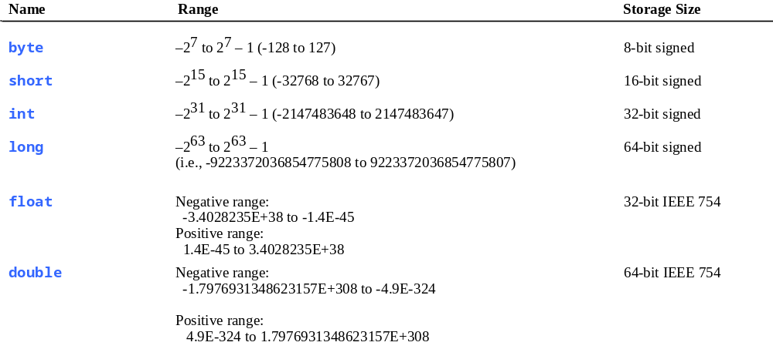
Numerical Data Types

Slide 10
Integers
Syntax:
    int variable_list;
  where variable_list is a comma-separated list of variable names. Each variable name may be followed by an optional assignment operator and a value for initialization.
  Eg: int a, b=10, c;
Integer is a class of variable types. The most basic one is int.
The size may change, but the leftmost bit is used for the sign. The remaining bits represent the value in binary.
Though the size of an int variable may vary, it is always limited, i.e., it contains a limited number of bits. Therefore, the maximum and minimum values that can be represented by an int variable is limited.

Slide 11
Integers
For example, assume in your system an integer has 16 bits.
Leftmost bit is used for the sign, so 15 bits are left for the value. So, you have 2¹⁵=32,768 positive values, ranging from 0 to 32,767. Similarly, you have 32,768 negative values, this time ranging from -1 to -32,768.
If you have 32 bits (4 bytes) for an integer, than the maximum value is 2³¹ - 1 = 2,147,483,647.
0
0
1
0
0
1
1
0
1
0
1
1
0
1
1
1
sign bit
value

Slide 12
Integers
There are variations of int such as long int, short int, unsigned int.
  For each one of these types, you may ignore the word "int" and use long, short, and unsigned, respectively.
The sizes of these types are ordered as follows:
    short int ≤ int ≤ long int

Slide 13
Floating-point numbers
Syntax:
    float variable_list;
Float type is used for real numbers.
Note that all integers may be represented as floating-point numbers, but not vice versa.

Slide 14
Floating-point numbers
Similar to integers, floats also have their limits: maximum and minimum values are limited as well as the precision.
Due to loss of precision, what you actually store might be this
, or this.
Lower limit
The value you want to store
Upper limit

Slide 15
Floating-point numbers
There are two variations of float: double and long double.
  They have wider range and higher precision.
The sizes of these types are ordered as follows:
    float ≤ double ≤ long double

Slide 16
Characters
Syntax:
    char variable_list;
Character is the only type that has a fixed size in all implementations: 1 byte.
All letters (uppercase and lowercase, separately), digits, and signs (such as +, -, !, ?, $, £, ^, #, comma itself, and many others) are of type character.

Slide 17
Characters
Since every value is represented with bits (0s and 1s), we need a mapping for all these letters, digits, and signs.
This mapping is provided by a table of characters and their corresponding integer values.
  The most widely used table for this purpose is the ASCII table.

Slide 18
Characters
The ASCII table contains the values for 256 values (of which only the first 128 are relevant for you).
Each row of the table contains one character.
The row number is called the ASCII code of the corresponding character.

Slide 19
Characters
Never memorize the ASCII codes. They are available in all programming books and the Internet. (Eg: http://www.ascii-code.com)
What is important for us is the following three rules:
  All lowercase letters (a,b,c,...) are consecutive.
  All uppercase letters (A,B,C,...) are consecutive.
  All digits are consecutive.

Slide 20
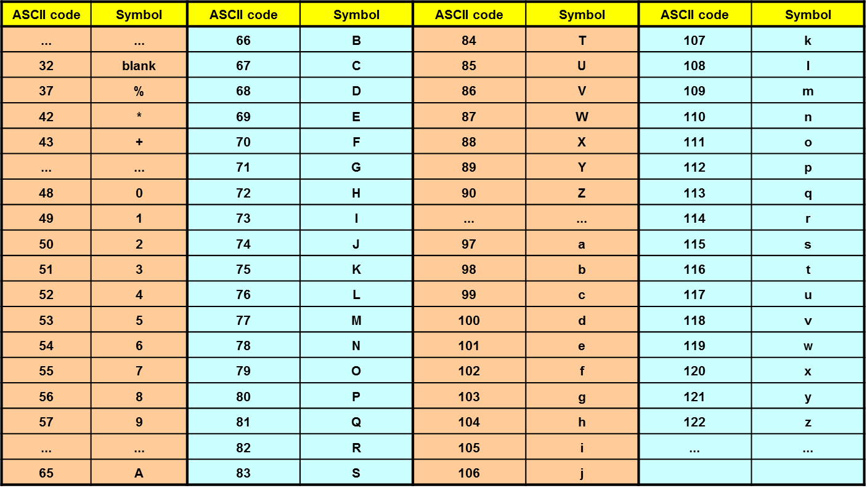
ASCII table (partial)

Slide 21
Characters
A character variable actually stores the ASCII value of the corresponding letter, digit, or sign.
I/O functions (printf(), scanf(), etc.) do the translation between the image of a character displayed on the screen and the ASCII code that is actually stored in the memory of the computer.

Slide 22
Characters
Note that a and A have different ASCII codes (97 and 65).
You could also have a variable with name a. To differentiate between the variable and the character, we specify all characters in single quotes, such as ‘a’. Variable names are never given in quotes.
  Example: char ch;
    ch=‘a’;
Note that using double quotes makes it a string (to be discussed later in the course) rather than a character. Thus, ‘a’ and "a" are different.
Similarly, 1 and ‘1’ are different. Former has the value 1 whereas the latter has the ASCII value of 49.

Slide 23
Characters
Example: Consider the code segment below.
    char ch;
    ch=‘A’;
    printf("Output is %c", ch);
  The string in printf() is stored as
    79,117,116,112,117,116,32,105,115,32,37,99
  which are the ASCII codes of the characters in the string.
  When printf() is executed, it first replaces 37,99 (%c) with 65 (A), and then displays the corresponding characters on the screen.

Slide 24
Constants
Syntax:
    #define CONSTANT_NAME constant_value
As the name implies, variables store values that vary while constants represent fixed values.
Note that there is no storage when you use constants. Actually, when you compile your program, the compiler replaces the constant name with the value you defined.
The pre-processor replaces every occurrence of constant_name with everything that is to the right of constant_name in the definition.
  Note that there is no semicolon at the end of the definition.
Conventionally, we use names in uppercase for constants.

Slide 25
Enumerated type
Used to define your own types.
Syntax:
    enum type_name {
    item_name=constant_int_value, ...
    } variable_list;
By default, the value of the first item is 0, and it increases by one for consecutive items. However, you may change the default value by specifying the constant value explicitly.
Eg: enum boolean {FALSE,TRUE} v1, v2;
    enum days {SUN,MON,TUE,WED,THU,FRI,SAT};
    enum {one=1,five=5,six,seven,ten=10,eleven} num;

Slide 26
Operators
Assignment operator (=)
  Note that this is not the "equals" operator. It should be pronounced as "becomes." (Equals is another operator.)
  The value of the expression on the RHS is assigned (copied) to the LHS.
  It has right-to-left associativity.
      a=b=c=10;
    makes all three variables 10.

Slide 27
Assignment and type conversion
When a variable of a narrower type is assigned to a variable of wider type, no problem.
  Eg: int a=10;
  float f;
  f=a;
However, there is loss of information in reverse direction.
  Eg: float f=10.9;
  int a;
  a=f;

Slide 28
Operators
Arithmetic operators (+, -, *, /, %)
  General meanings are obvious.
  What is important is the following: If one of the operands is of a wider type, the result is also of that type. (Its importance will be more obvious soon.)
    Eg: Result of int+float is float. Result of float+double is double.

Slide 29
Operators
Logic operators (&&, ||, !)
  Logic operators take integer class operands.
    Zero means false.
    Anything non-zero means true.
  "&&" does a logical-AND operation. (True only if both operands are true.)
  "||" does a logical-OR operation. (False only if both operands are false.)
  "!" does a negation operation. (Converts true to false, and false to true.)

Slide 30
Operators
Logic operators follow the logic rules
The order of evaluation is from left to right
As usual parenthesis overrides default order
a | b | a && b | a || b
true | true | true | true
true | false | false | true
false | true | false | true
false | false | false | false

Slide 31
Operators
  If the first operand of the "&&" operator is false, the second operand is not evaluated at all (since it is obvious that the whole expression is false).
    Eg: In the expression below, if the values of a, b and c are initially 1, 0 and 1, respectively,
    a == b && (c=2)
    then the second operand is not evaluated at all, so c keeps its value as 1.
  Similarly, if the first operand of the "||" operator is true, the second operand is not evaluated at all.

Slide 32
Operators
Bitwise operators (&, |, ^, <<, >>, ~)
  Bitwise operators take integer operands.
    For the logic operators, the variable represents a single logical value, true or false.
    For the bitwise operators, each bit of the variable represents true or false.
  &, |, and ^ perform bitwise-AND, -OR, -XOR, respectively.
  << and >> perform left- and right-shifts.
  "~" takes bitwise one’s complement.

Slide 33
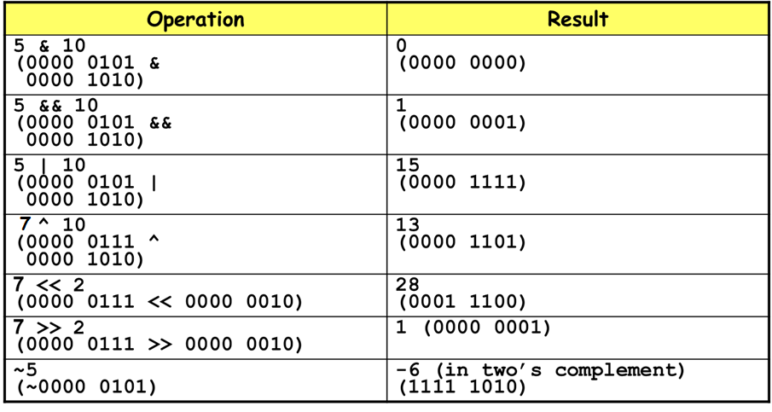
Operators

Slide 34
Operators
Other assignment operators (+=, -=, *=, /=, %=)
  Instead of writing a=a+b, you can write a+=b in short. Similar with -=, *=, /=, and others.

Slide 35
Operators
Pre/Post increment/decrement operators (++, --)
  The operator ++ increments the value of the operand by 1.
    If the operator comes BEFORE the variable name, the value of the variable is incremented before being used.
      i.e., the value of the expression is the incremented value. This is pre-increment.
    In post-increment, the operator is used after the variable name, and incrementation is performed after the value is used.
      i.e., the value of the expression is the value of the variable before incrementation.

Slide 36
Operators
  Eg: a=10; c=10,
  b=++a; d=c++;
    Both a and c will be come 11, but b will be 11 while d is 10.

Slide 37
Comparison Operators
Comparison operators (==, !=, <, <=, ...)
  "==" is the "is equal to" operator. Like all other comparison operators, it evaluates to a Boolean value of true or false, no matter what the operand types are.
  IMPORTANT: When you compare two float values that are supposed to be equal mathematically, the comparison may fail due to the loss of precision discussed before.

Slide 38
Comparison Operators
Symbol | Usage | Meaning
== | x == y | is x equal to y?
!= | x != y | is x not equal to y?
> | x > y | is x greater than y?
< | x < y | is x less than y?
>= | x >= y | is x greater than or equal to y?
<= | x <=y | is x less than or equal to y?

Slide 39
Logic Operators
We can create complex expressions by joining several expressions with logic operators.
Symbol | Usage | Meaning
&& | exp1 && exp2 | AND
|| | exp1 || exp2 | OR
! | ! exp | NOT

Slide 40
Operator precedence table
Operator | Associativity
() [] . -> ++(postincrement) –-(postdecrement) | left-to-right
++(preincrement) --(predecrement) + - ! ~ (type) * & sizeof | right-to-left
* / % | left-to-right
+ - | left-to-right
<< >> | left-to-right
< <= > >= | left-to-right
== != | left-to-right
& | left-to-right
^ | left-to-right
| | left-to-right
&& | left-to-right
|| | left-to-right
?: | right-to-left
= += -= *= /= %= &= ^= |= <<= >>= | right-to-left
, | left-to-right

Slide 41
Operators
Precedence, associativity, and order of evaluation:
  In the table that is given in the previous slide, precedence decreases as you go down.
  If two operands in an expression have the same precedence, you decide according to the associativity column.
  There is a common misunderstanding about associativity.
    Note that associativity has nothing to do with the order of evaluation of the operands.
    Order of evaluation of operands is not specified in C language.

Slide 42
Type casting
Also called conversion or type conversion.
It does NOT change the type of a variable. It is not possible to change the type of a variable.
What casting does is to convert the type of a value.

Slide 43
Type casting
Eg: int a=10, b=3;
float f, g;
f=a/b;
g=(float)a/b;
The type of a does not change; it is still and integer. However, in the expression (float)a/b, the value of a, which is 10, is converted to float value of 10.0, and then it is divided by b, which is 3. Thus, we perform float division and g becomes 3.3333...
On the other hand, we perform an integer division for f, so it becomes 3.

